Slide 1

TELCO CUSTOMER CHURN PREDICTION
BY CHETNA MANCHANDA

Slide 2

BACKGROUND
DATA REVEALS WHY CUSTOMERS LEAVE
01
INTRODUCTION
Telecom companies faces a critical challenge in retaining customers. Every lost customer leads to a drop in recurring revenue, higher marketing costs, and missed opportunities for long-term engagement. This project addresses the growing issue of churn using real-world data and predictive modeling to help businesses act before customers leave.
02
03
OBJECTIVE
UNDERSTANDING WHY CUSTOMERS LEAVE
The objective of this project is to analyze customer churn patterns in the telecom sector and develop predictive models to identify customers likely to leave. Using historical customer data and machine learning techniques, the goal is to uncover key factors driving churn and build accurate models that support proactive customer retention strategies.
Customers churn due to reasons such as better offers from competitors, unresolved service complaints, unclear billing, and lack of loyalty programs. Analyzing behavioral patterns from historical data helps uncover these causes and enables targeted actions for churn prevention.

Slide 3





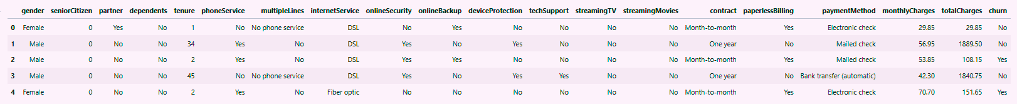
THE DATA BEHIND THE CHURN
- DATA DESCRIPTION
Demographics (Categorical)
Account & Billing Information (Categorical)
Target
Variable
Churn (Yes/No)
Type: Binary Classification Target
gender, SeniorCitizen, Partner, Dependents
Contract, PaperlessBilling, PaymentMethod
Dataset Overview
Service Details (Categorical)
Account & Billing Information (Numerical)
PhoneService, MultipleLines, InternetService, OnlineSecurity, OnlineBackup, DeviceProtection, TechSupport, StreamingTV, StreamingMovies
7,043 rows
21 columns
MonthlyCharges, TotalCharges, tenure

Slide 4


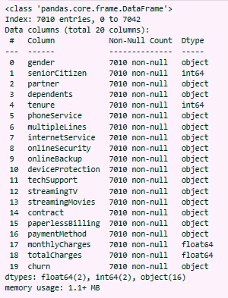
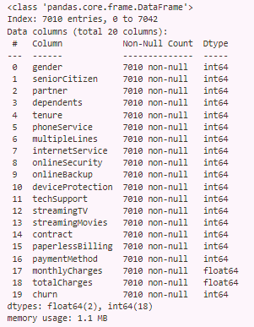
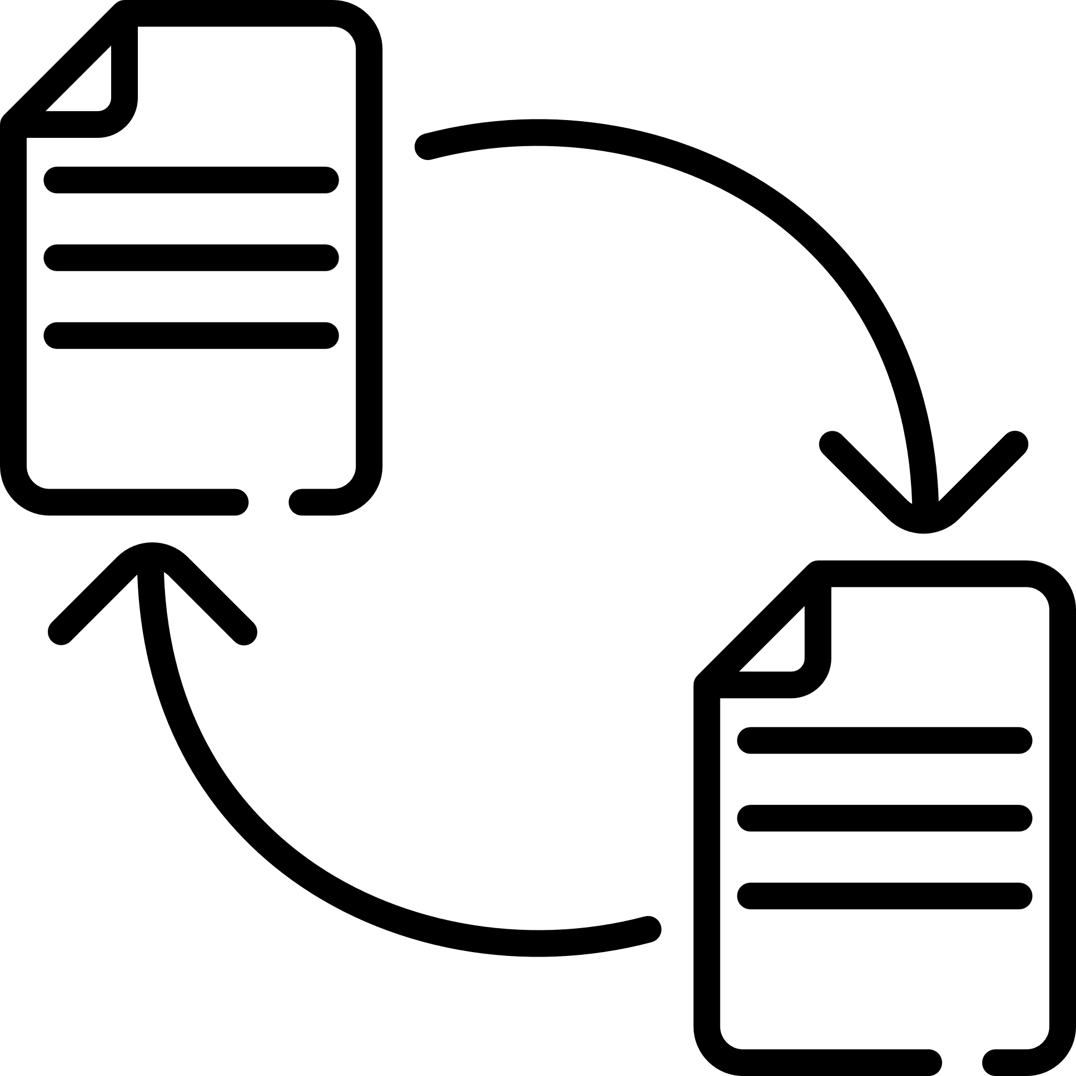




Remove Irrelevant Columns
Dropped the customerID column as it does not contribute to churn prediction.
DATA CLEANING & PREPROCESSING
Check for Missing and Duplicate Values
No duplicates and no missing values initially
Convert totalCharges to Numeric
The totalCharges column was incorrectly stored as object type.
Converted it to numeric using pd.to_numeric() with errors='coerce'
Handle Missing Values
After conversion, 11 rows had missing totalCharges values.
These rows were removed to ensure clean numerical analysis.
Encode Categorical Data
Mapped all categorical variables to numerical values for model compatibility.
Included binary maps (e.g., Yes/No = 1/0) and multi-class mappings (e.g., InternetService: DSL = 0, Fiber optic = 1, etc.).
Data is now fully structured and model-ready
Final Dataset Summary
Rows after cleaning: 7,010
Columns: 20

Slide 5
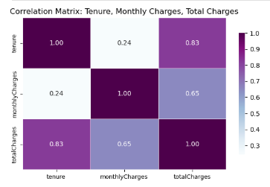
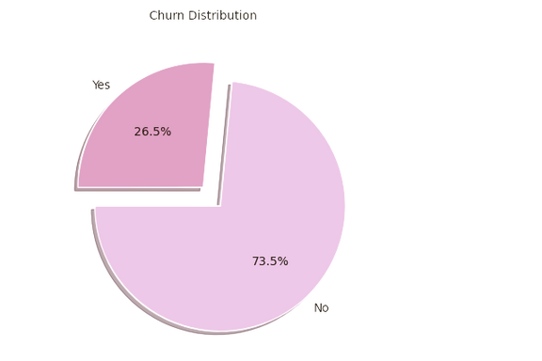
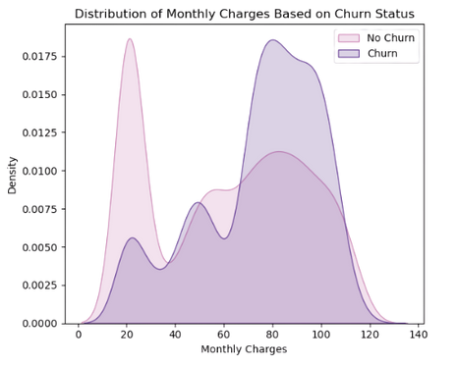
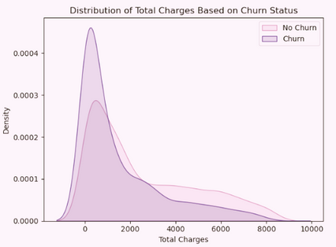
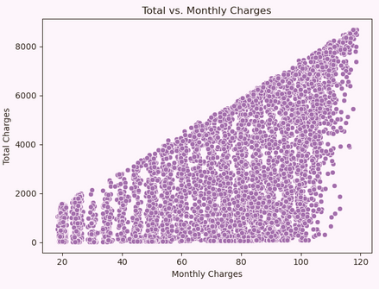
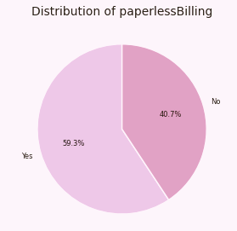
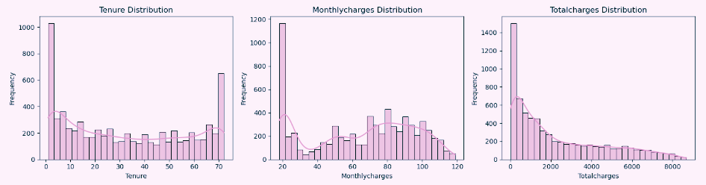
I
N
S
I
G
H
T
S
EDA
K
E
Y
WHAT THE DATA TELLS US – KEY CHURN INSIGHTS
Only 26.5% of customers have churned, while 73.5% stayed, indicating class imbalance that must be handled before modeling. (using SMOTE).
Customers with higher monthly charges tend to churn more often, showing a clear relationship between cost and customer retention.
Contract type has the strongest negative correlation with churn (-0.40), suggesting that customers with longer contracts (one-year or two-year) are significantly less likely to churn compared to those on month-to-month plans.
Customers with high monthly charges but low total charges are more prone to churn, indicating that newer, high-paying users are less likely to stay.
Customers without tech support or online security churn more frequently, indicating that support services contribute to retention.
Paperless billing users show slightly higher churn, possibly due to less engagement or weaker brand connection.
Total charges and tenure have a strong positive correlation, indicating that customers who stay longer tend to accumulate higher total charges—reinforcing the insight that loyal, long-term customers contribute more revenue and are less likely to churn.

Slide 6
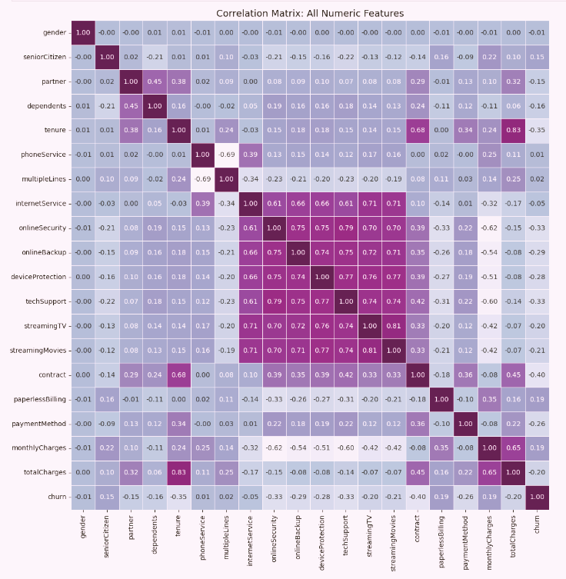
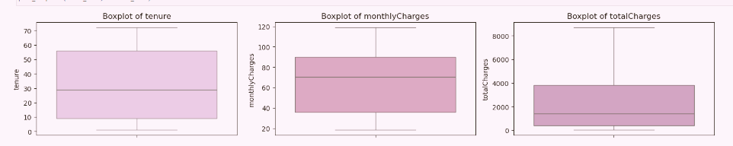
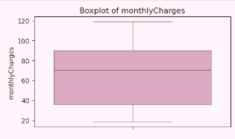
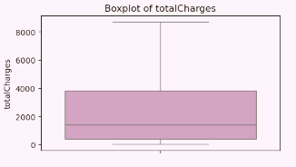
NO
O
U
T
L
I
E
R

Slide 7
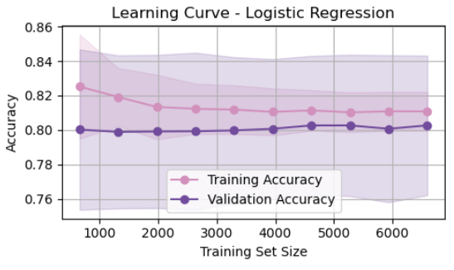
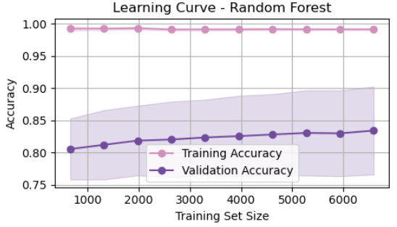
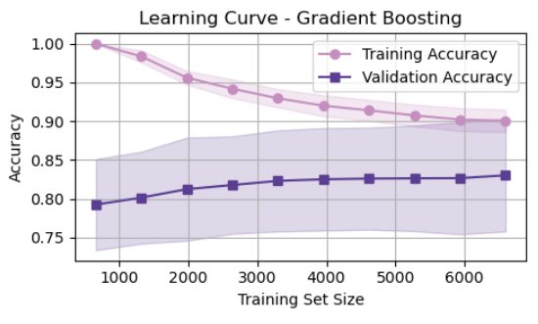
MODELING APPROACH
STRATEGY BEHIND OUR PREDICTIONS
To predict customer churn effectively, we selected a combination of simple and ensemble machine learning models that balance accuracy, interpretability, and robustness.
Logistic Regression is a simple and interpretable linear classification model used as a baseline for predicting customer churn. In our project, it provided consistent results with minimal overfitting, as observed in the learning curve. However, its linear nature limited its ability to capture complex churn patterns compared to ensemble models.
Random Forest is an ensemble model that combines multiple decision trees, making it well-suited for handling mixed data types in our churn dataset. It delivered strong performance and useful feature importance insights to identify churn drivers. The learning curve showed high training accuracy and stable validation scores, confirming its robustness even with SMOTE-balanced data.
Gradient Boosting is a sequential ensemble technique that corrects errors iteratively, making it ideal for capturing complex patterns in imbalanced churn data. It showed strong performance in balancing precision and recall, making it highly effective for churn prediction. The learning curve reflected steady validation improvement and good generalization as training size increased.

Slide 8
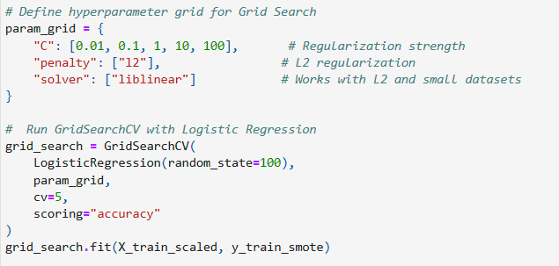
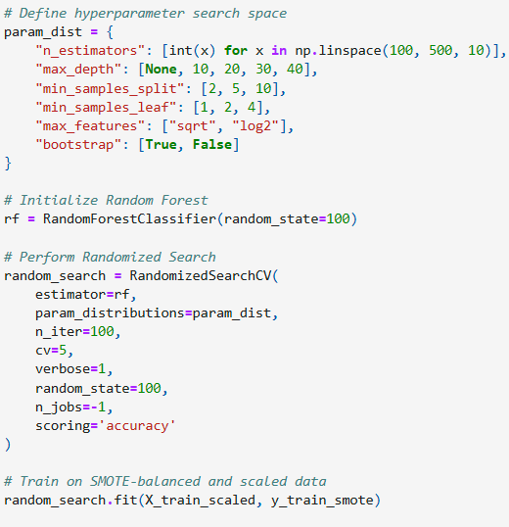
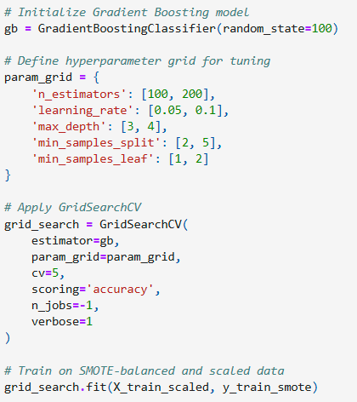
MODEL OPTIMIZATION
SMOTE | Our target variable, churn, was highly imbalanced. Used SMOTE to balance classes. Boosted recall and F1-score for the minority class
LOGISTIC REGRESSION | Default hyperparameters led to underfitting on imbalanced data. Used GridSearchCV with 5-fold cross-validation to find the optimal configuration. This improved accuracy and stability, balancing precision and recall for churn prediction.
RANDOM FOREST | Default settings risk overfitting and miss optimal tree count. Used RandomizedSearchCV for efficient parameter search. Improved accuracy and reduced overfitting for better generalization.
 | Default parameters can slow learning or cause overfitting. Used GridSearchCV to fine-tune key boosting settings. Improved precision and model performance with balanced learning.
BALANCING THE DATASET AND FINE-TUNING ALGORITHMS
GRADIENT BOOSTING

Slide 9
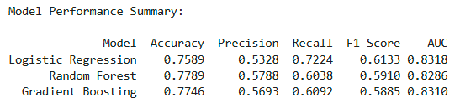
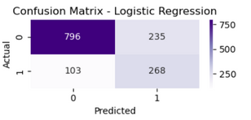
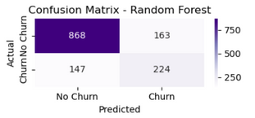

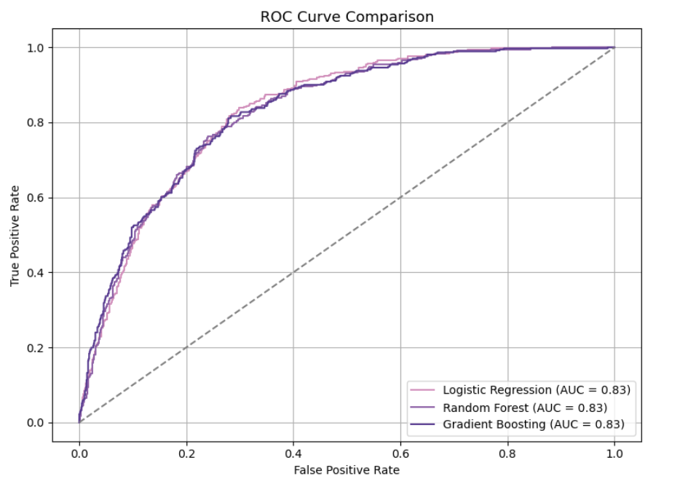
Overall Model Comparison
EVALUATION
Logistic Regression performed best on Recall (0.7224) and F1-Score (0.6133), making it more sensitive to detecting churn cases.
Random Forest had the highest accuracy (0.7789) but a lower recall, indicating a tradeoff between correctness and sensitivity.
Gradient Boosting had consistent performance across metrics but slightly underperformed on recall.
AUC & ROC Curve Insights
All three models had similar AUC values (~0.83), showing they are comparably good at distinguishing churn vs. non-churn.
Slight edge to Logistic Regression, which maintains a strong balance between TPR and FPR — important for customer churn use cases.
Confusion Matrix Observations
Logistic Regression captured the most true churn cases (268) with fewer false negatives (103).
Random Forest and Gradient Boosting had higher false negatives, meaning they missed more churn cases.
For churn prediction, minimizing false negatives is key — Logistic Regression proved more effective here.
LOGISTIC REGRESSION LEADS CHURN PREDICTION.

Slide 10
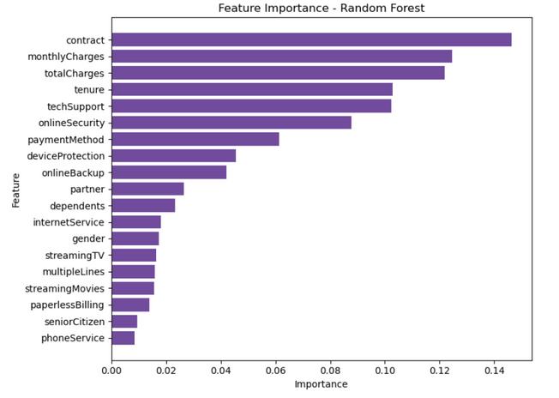
FEATURE
IMPORTANCE
IMPLICATIONS
Promote Long-Term Contracts: Encourage customers to switch from month-to-month to annual/two-year plans to reduce churn risk. Long-term plans increase customer commitment and reduce the likelihood of short-term cancellations.
Target High Monthly Charge Customers Early: Offer discounts, loyalty rewards, or added services to retain high-paying but at-risk users.
Invest in Support & Security Services: Customers with tech support and online security are less likely to churn — bundle these features or promote them more.
Reward Long-Term Tenure: Introduce tenure-based perks to make loyal customers feel valued and reduce voluntary churn. Acknowledging loyalty through personalized rewards encourages continued engagement.
Segment Customers by Risk: Use the model predictions to identify high-risk customers and launch proactive retention campaigns.
Reconsider Payment Method Design: Investigate churn patterns around specific payment methods — e.g., users with “Electronic Check” may feel less secure. Shifting focus to modern, trusted methods can enhance user confidence and ease of payment.
Improve Onboarding for New Customers: Since churn is higher among low-tenure users, optimize onboarding and engagement in the first few months to build long-term relationships. Effective onboarding ensures customers understand and utilize the full range of services.
Contract type is the most influential factor — customers with month-to-month contracts are more likely to churn.
Monthly Charges and Total Charges are critical — higher bills correlate with increased churn risk.
Tenure plays a strong role — shorter customer relationships show higher churn tendency.
Tech Support and Online Security are major contributors — lack of support/security features may drive churn.
Payment Method and Device Protection also impact churn — digital and less secure methods may reduce loyalty.
Features like Phone Service, Senior Citizen, and Paperless Billing have minimal predictive value.

Slide 11
RECOMMENDATIONS
Business Recommendations
Adopt a Data-Driven Retention Strategy: Use churn predictions to proactively target high-risk customers with personalized offers.
Prioritize Value-Adding Services: Promote bundles including tech support, streaming, and security—features strongly tied to customer retention.
Improve Payment Experience: Investigate and optimize underperforming payment methods, especially those linked to higher churn.
Create Tiered Loyalty Programs: Reward tenure and consistent engagement with perks to reduce voluntary churn.
Focus on Early Engagement: Strengthen onboarding for new users, particularly those on month-to-month plans.
Technical Recommendations
Enhance Data Collection: Capture more behavioral metrics (e.g., login frequency, service usage) for deeper churn insights.
Update Dataset Regularly: Periodic updates will help track evolving churn patterns and maintain model accuracy.
Deploy Model in Production: Integrate churn model into CRM or customer support systems for real-time alerts.
Test Additional Algorithms: Explore more advanced models like XGBoost, LightGBM, or even Neural Networks.
Monitor Model Performance: Continuously evaluate and retrain the model as new data becomes available.
Address Class Imbalance Proactively: Continue using techniques like SMOTE or experiment with ensemble balancing to ensure fair model learning.
CONCLUSION
Our analysis identified key factors driving customer churn, including contract type, monthly charges, and support features.
Logistic Regression emerged as the most balanced model, offering strong recall and F1-score, essential for churn prediction.
Business strategies like contract upgrades, early interventions, and service bundling can effectively reduce churn.
Technically, addressing class imbalance, improving data quality, and regularly updating the model will enhance long-term performance.
With data-driven action, the company can proactively retain customers, optimize revenue, and boost loyalty.

Slide 12

THANK YOU

